Slide 1

Database System Concepts and Architecture
Instructor: tania iram

Slide 2
Agenda
Data Models and Their Categories
Schemas, Instances, and States
Three-Schema Architecture
Data Independence
DBMS Languages and Interfaces
Database System Utilities and Tools
Centralized and Client-Server Architectures
Classification of DBMSs

Slide 3

Data Models
Data Model:
A set of concepts to describe the structure of a database, the operations for manipulating these structures, and certain constraints that the database should obey.
Data Model Structure and Constraints:
Constructs are used to define the database structure
Constructs typically include elements (and their data types) as well as groups of elements (e.g. entity, record, table), and relationships among such groups
Constraints specify some restrictions on valid data; these constraints must be enforced at all times
Slide 2- 3
Notes:
3

Slide 4
Categories of Data Models
Conceptual (high-level, semantic) data models:
Provide concepts that are close to the way many users perceive data.
(Also called entity-based or object-based data models.)
Physical (low-level, internal) data models:
Provide concepts that describe details of how data is stored in the computer. These are usually specified in an ad-hoc manner through DBMS design and administration manuals
Implementation (representational) data models:
Provide concepts that fall between the above two, used by many commercial DBMS implementations (e.g. relational data models used in many commercial systems).
Self-Describing Data Models:
Combine the description of data with the data values. Examples include XML, key-value stores and some NOSQL systems.
Slide 2- 4
Notes:
4

Slide 5
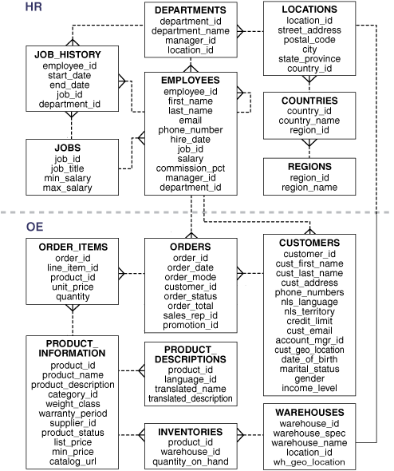
Schemas versus Instances
Database Schema:
The description of a database.
Includes descriptions of the database structure, data types, and the constraints on the database.
Schema Diagram:
An illustrative display of (most aspects of) a database schema.
Schema Construct:
A component of the schema or an object within the schema, e.g., STUDENT, COURSE.
Slide 2- 5
Notes:
5

Slide 6
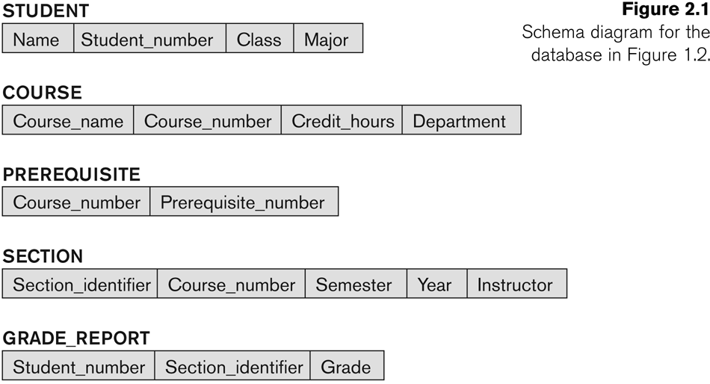
Example of a Database Schema
Slide 2- 6

Slide 7
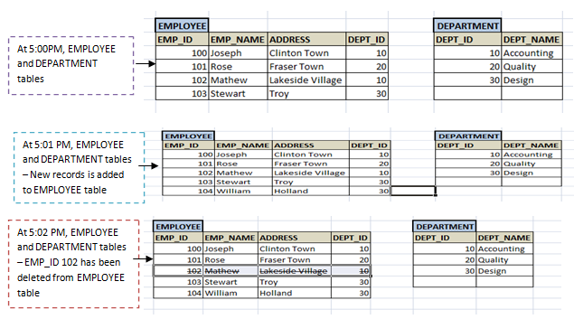
Schemas versus Instances
Database State:
The actual data stored in a database at a particular moment in time. This includes the collection of all the data in the database.
Also called database instance (or occurrence or snapshot).
The term instance is also applied to individual database components, e.g. record instance, table instance, entity instance
Slide 2- 7
Notes:
7

Slide 8
Database Schema vs. Database State
Database State:
Refers to the content of a database at a moment in time.
Initial Database State:
Refers to the database state when it is initially loaded into the system.
Valid State:
A state that satisfies the structure and constraints of the database.
Slide 2- 8
Notes:
8

Slide 9
Database Schema vs. Database State (continued)
Distinction
The database schema changes very infrequently.
The database state changes every time the database is updated.
Schema is also called intension.
State is also called extension.
Slide 2- 9
Notes:
9

Slide 10
Three-Schema Architecture
Proposed to support DBMS characteristics of:
Program-data independence.
Support of multiple views of the data.
Not explicitly used in commercial DBMS products, but has been useful in explaining database system organization
Slide 2- 10
Notes:
10

Slide 11
Three-Schema Architecture
Defines DBMS schemas at three levels:
Internal schema at the internal level to describe physical storage structures and access paths (e.g indexes).
Typically uses a physical data model.
Conceptual schema at the conceptual level to describe the structure and constraints for the whole database for a community of users.
Uses a conceptual or an implementation data model.
External schemas at the external level to describe the various user views.
Usually uses the same data model as the conceptual schema.
Slide 2- 11
Notes:
11

Slide 12
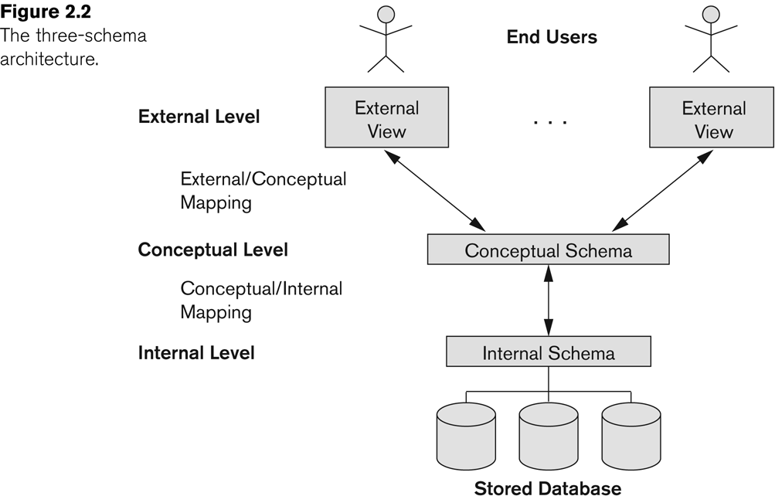
The three-schema architecture
Slide 2- 12

Slide 13
Three-Schema Architecture
Mappings among schema levels are needed to transform requests and data.
Programs refer to an external schema, and are mapped by the DBMS to the internal schema for execution.
Data extracted from the internal DBMS level is reformatted to match the user’s external view (e.g. formatting the results of an SQL query for display in a Web page)
Slide 2- 13
Notes:
13

Slide 14
Data Independence
Logical Data Independence:
The capacity to change the conceptual schema without having to change the external schemas and their associated application programs.
Physical Data Independence:
The capacity to change the internal schema without having to change the conceptual schema.
For example, the internal schema may be changed when certain file structures are reorganized or new indexes are created to improve database performance
Slide 2- 14
Notes:
14

Slide 15
Data Independence (continued)
When a schema at a lower level is changed, only the mappings between this schema and higher-level schemas need to be changed in a DBMS that fully supports data independence.
The higher-level schemas themselves are unchanged.
Hence, the application programs need not be changed since they refer to the external schemas.
Slide 2- 15
Notes:
15

Slide 16
DBMS Languages
Data Definition Language (DDL)
Data Manipulation Language (DML)
High-Level or Non-procedural Languages: These include the relational language SQL
May be used in a standalone way or may be embedded in a programming language
Low Level or Procedural Languages:
These must be embedded in a programming language
Slide 2- 16
Notes:
16

Slide 17
DBMS Languages
Data Definition Language (DDL):
Used by the DBA and database designers to specify the conceptual schema of a database.
In many DBMSs, the DDL is also used to define internal and external schemas (views).
In some DBMSs, separate storage definition language (SDL) and view definition language (VDL) are used to define internal and external schemas.
SDL is typically realized via DBMS commands provided to the DBA and database designers
Slide 2- 17
Notes:
17

Slide 18
DBMS Languages
Data Manipulation Language (DML):
Used to specify database retrievals and updates
DML commands (data sublanguage) can be embedded in a general-purpose programming language (host language), such as COBOL, C, C++, or Java.
A library of functions can also be provided to access the DBMS from a programming language
Alternatively, stand-alone DML commands can be applied directly (called a query language).
Slide 2- 18
Notes:
18

Slide 19
Types of DML
High Level or Non-procedural Language:
For example, the SQL relational language
Are “set”-oriented and specify what data to retrieve rather than how to retrieve it.
Also called declarative languages.
Low Level or Procedural Language:
Retrieve data one record-at-a-time;
Constructs such as looping are needed to retrieve multiple records, along with positioning pointers.
Slide 2- 19
Notes:
19

Slide 20
DBMS Interfaces
Stand-alone query language interfaces
Example: Entering SQL queries at the DBMS interactive SQL interface (e.g. SQL*Plus in ORACLE)
Programmer interfaces for embedding DML in programming languages
User-friendly interfaces
Menu-based, forms-based, graphics-based, etc.
Mobile Interfaces:interfaces allowing users to perform transactions using mobile apps
Slide 2- 20
Notes:
20

Slide 21
DBMS Interfaces
Stand-alone query language interfaces
Example: Entering SQL queries at the DBMS interactive SQL interface (e.g. SQL*Plus in ORACLE)
Programmer interfaces for embedding DML in programming languages
User-friendly interfaces
Menu-based, forms-based, graphics-based, etc.
Mobile Interfaces:interfaces allowing users to perform transactions using mobile apps
Slide 2- 21
Notes:
21

Slide 22
DBMS Programming Language Interfaces
Programmer interfaces for embedding DML in a programming languages:
Embedded Approach: e.g embedded SQL (for C, C++, etc.), SQLJ (for Java)
Procedure Call Approach: e.g. JDBC for Java, ODBC (Open Databse Connectivity) for other programming languages as API’s (application programming interfaces)
Database Programming Language Approach: e.g. ORACLE has PL/SQL, a programming language based on SQL; language incorporates SQL and its data types as integral components
Scripting Languages: PHP (client-side scripting) and Python (server-side scripting) are used to write database programs.
Slide 2- 22
Notes:
22

Slide 23
User-Friendly DBMS Interfaces
Menu-based (Web-based), popular for browsing on the web
Forms-based, designed for naïve users used to filling in entries on a form
Graphics-based
Point and Click, Drag and Drop, etc.
Specifying a query on a schema diagram
Natural language: requests in written English
Combinations of the above:
For example, both menus and forms used extensively in Web database interfaces
Slide 2- 23
Notes:
23

Slide 24
Other DBMS Interfaces
Natural language: free text as a query
Speech : Input query and Output response
Web Browser with keyword search
Parametric interfaces, e.g., bank tellers using function keys.
Interfaces for the DBA:
Creating user accounts, granting authorizations
Setting system parameters
Changing schemas or access paths
Slide 2- 24
Notes:
24

Slide 25
Database System Utilities
To perform certain functions such as:
Loading data stored in files into a database. Includes data conversion tools.
Backing up the database periodically on tape.
Reorganizing database file structures.
Performance monitoring utilities.
Report generation utilities.
Other functions, such as sorting, user monitoring, data compression, etc.
Slide 2- 25
Notes:
25

Slide 26
Other Tools
Data dictionary / repository:
Used to store schema descriptions and other information such as design decisions, application program descriptions, user information, usage standards, etc.
Active data dictionary is accessed by DBMS software and users/DBA.
Passive data dictionary is accessed by users/DBA only.
Slide 2- 26
Notes:
26

Slide 27
Other Tools
Application Development Environments and CASE (computer-aided software engineering) tools:
Examples:
PowerBuilder (Sybase)
JBuilder (Borland)
JDeveloper 10G (Oracle)
Slide 2- 27
Notes:
27

Slide 28
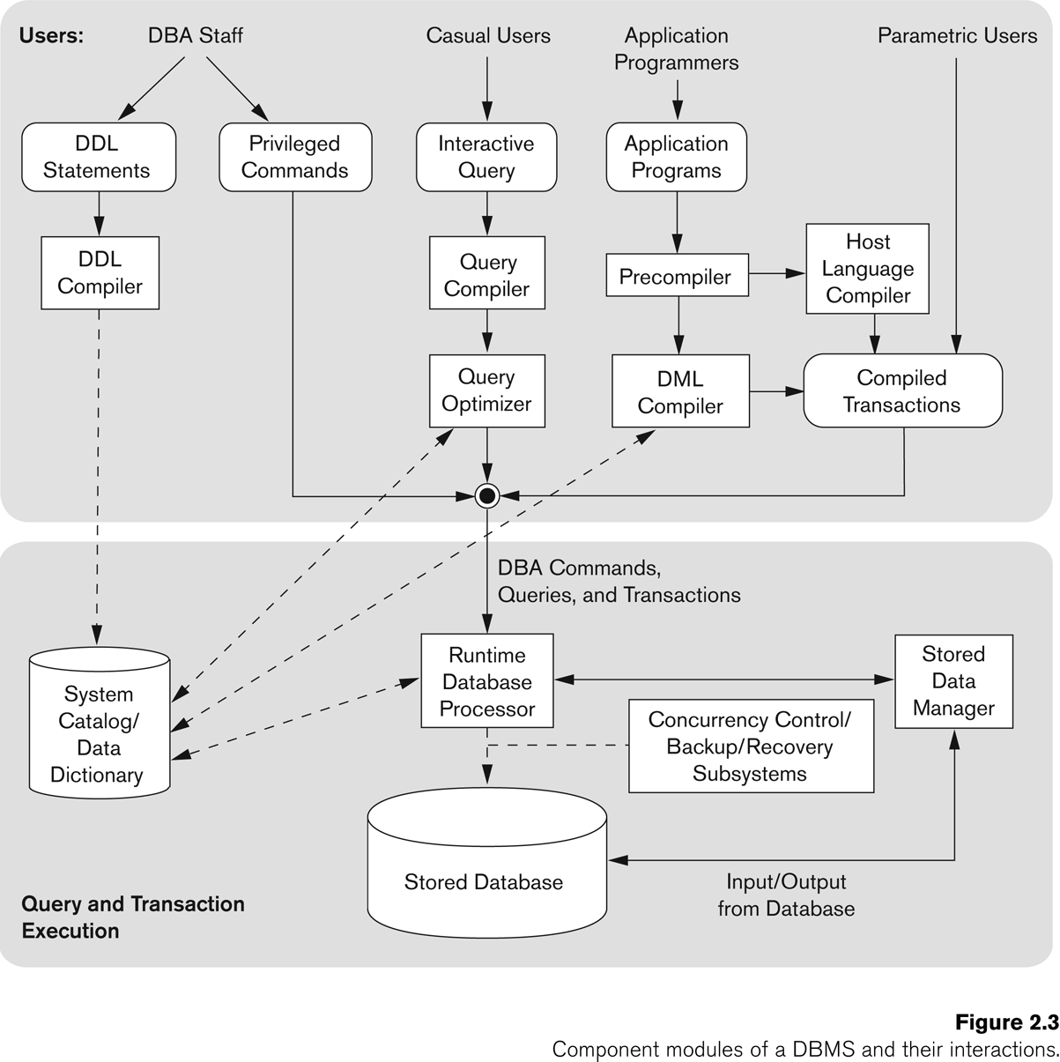
Typical DBMS Component Modules
Slide 2- 28

Slide 29
Centralized and Client-Server DBMS Architectures
Centralized DBMS:
Combines everything into single system including- DBMS software, hardware, application programs, and user interface processing software.
User can still connect through a remote terminal – however, all processing is done at centralized site.
Slide 2- 29
Notes:
29

Slide 30
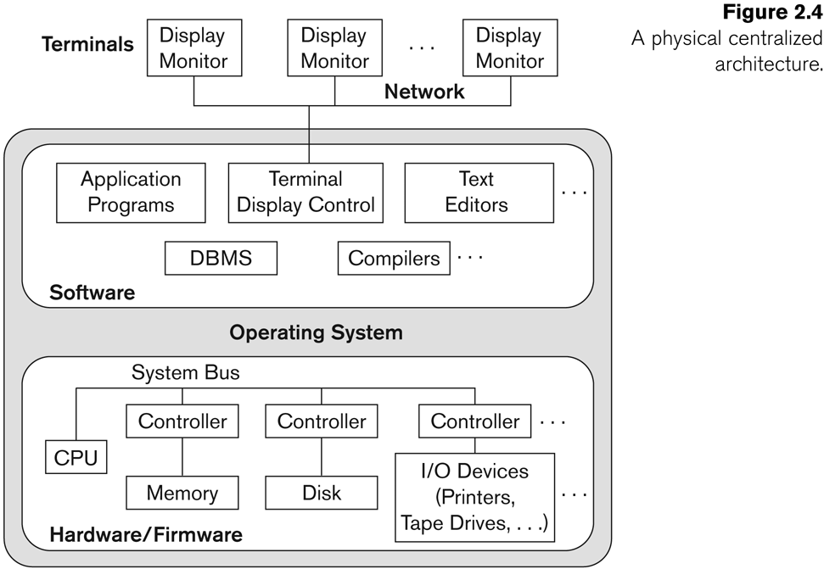
A Physical Centralized Architecture
Slide 2- 30

Slide 31
Basic 2-tier Client-Server Architectures
Specialized Servers with Specialized functions
Print server
File server
DBMS server
Web server
Email server
Clients can access the specialized servers as needed
Slide 2- 31
Notes:
31

Slide 32
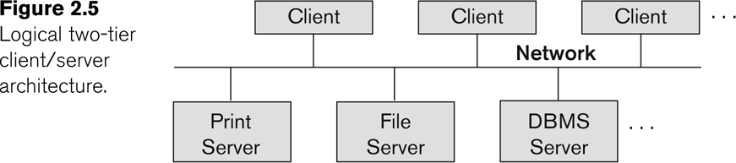
Logical two-tier client server architecture
Slide 2- 32

Slide 33
Clients
Provide appropriate interfaces through a client software module to access and utilize the various server resources.
Clients may be diskless machines or PCs or Workstations with disks with only the client software installed.
Connected to the servers via some form of a network.
(LAN: local area network, wireless network, etc.)
Slide 2- 33
Notes:
33

Slide 34
DBMS Server
Provides database query and transaction services to the clients
Relational DBMS servers are often called SQL servers, query servers, or transaction servers
Applications running on clients utilize an Application Program Interface (API) to access server databases via standard interface such as:
ODBC: Open Database Connectivity standard
JDBC: for Java programming access
Slide 2- 34
Notes:
34

Slide 35
Two Tier Client-Server Architecture
Client and server must install appropriate client module and server module software for ODBC or JDBC
A client program may connect to several DBMSs, sometimes called the data sources.
In general, data sources can be files or other non-DBMS software that manages data.
See Chapter 10 for details on Database Programming
Slide 2- 35
Notes:
35

Slide 36
Three Tier Client-Server Architecture
Common for Web applications
Intermediate Layer called Application Server or Web Server:
Stores the web connectivity software and the business logic part of the application used to access the corresponding data from the database server
Acts like a conduit for sending partially processed data between the database server and the client.
Three-tier Architecture Can Enhance Security:
Database server only accessible via middle tier
Clients cannot directly access database server
Clients contain user interfaces and Web browsers
The client is typically a PC or a mobile device connected to the Web
Slide 2- 36
Notes:
36

Slide 37
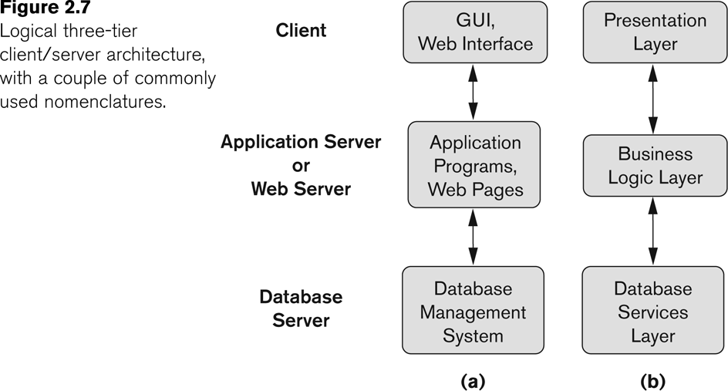
Three-tier client-server architecture
Slide 2- 37

Slide 38
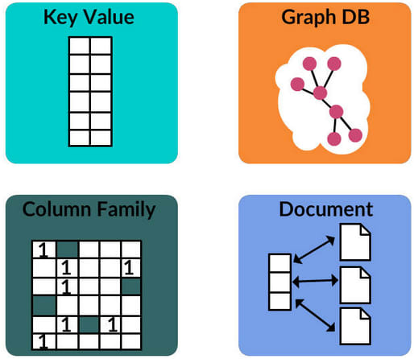
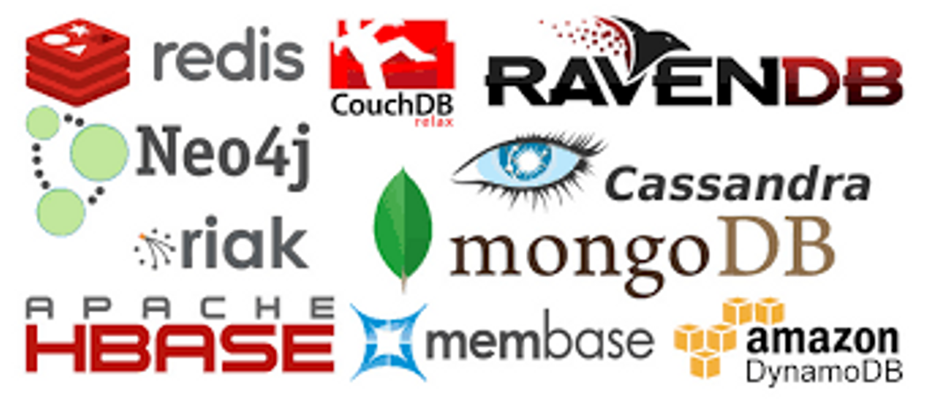
Classification of DBMSs
Based on the data model used
Legacy: Network, Hierarchical.
Currently Used: Relational, Object-oriented, Object-relational
Recent Technologies: Key-value storage systems, NOSQL systems: document based, column-based, graph-based and key-value based. Native XML DBMSs.
Other classifications
Single-user (typically used with personal computers) vs.
multi-user (most DBMSs).
Centralized (uses a single computer with one database)
vs.
distributed (multiple computers, multiple DBs)
Slide 2- 38
Notes:
38

Slide 39
Variations of Distributed DBMSs (DDBMSs)
Homogeneous DDBMS
Heterogeneous DDBMS
Federated or Multidatabase Systems
Participating Databases are loosely coupled with high degree of autonomy.
Distributed Database Systems have now come to be known as client-server based database systems because:
They do not support a totally distributed environment, but rather a set of database servers supporting a set of clients.
Slide 2- 39
Notes:
39

Slide 40
Cost considerations for DBMSs
Cost Range: from free open-source systems to configurations costing millions of dollars
Examples of free relational DBMSs: MySQL, PostgreSQL, others
Commercial DBMS offer additional specialized modules, e.g. time-series module, spatial data module, document module, XML module
These offer additional specialized functionality when purchased separately
Sometimes called cartridges (e.g., in Oracle) or blades
Different licensing options: site license, maximum number of concurrent users (seat license), single user, etc.
Slide 2- 40
Notes:
40

Slide 41
Other Considerations
Type of access paths within database system
E.g.- inverted indexing based (ADABAS is one such system).Fully indexed databases provide access by any keyword (used in search engines)
General Purpose vs. Special Purpose
E.g.- Airline Reservation systems or many others-reservation systems for hotel/car etc. Are special purpose OLTP (Online Transaction Processing Systems)
Slide 2- 41

